Slide 1
Week 4 – Thursday: Recursion pt. 2
R. Jordan Crouser
Assistant Professor of Computer Science
Smith College
SCS Noonan Scholars – Summer 2018

Slide 2

Lab 12 debrief
What was hard about these?

Slide 3
Jordan’s observations
How do you tell whether a list is sorted?
How far will this loop go?
(very common source of “it doesn’t sort the last item” bugs)
1 person got the time module to work and reported the correct answer: sorted(…)
remember: include the actual values for each method

Slide 4
Jordan’s meta observations
10 / 11 people turned something in (7 submissions)
4 / 7 actually ran (3 had invalid syntax and didn’t run at all, one ran but threw a NameError)
Some didn’t understand what a question was asking:
…but no one messaged me about it ☹

Slide 6
Outline
Motivating example: Towers of Hanoi
Fractals (quick introduction)
Lab 12: Debrief
Recap
How recursion works under the hood
Iterative vs. recursive solutions
More recursion & recursive functions
Break
Lab

Slide 8
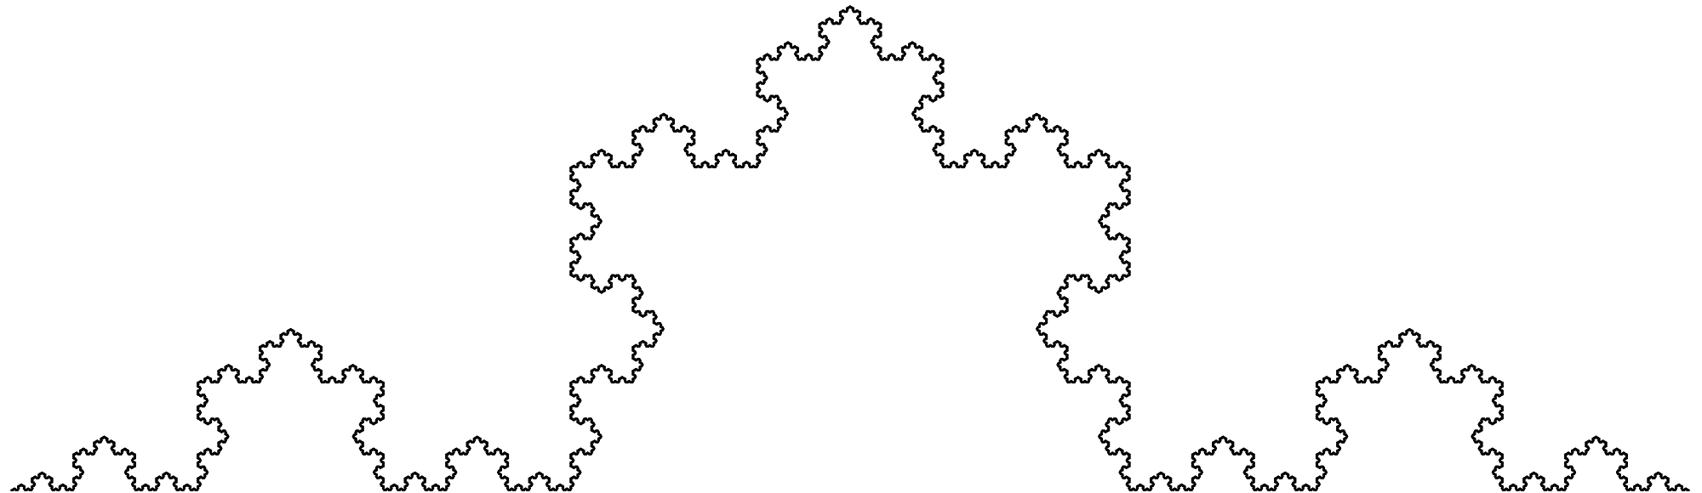
Recap
What’s the big idea
behind recursion?

Slide 9
Recursion themes
“Looping without a loop”
“A function that calls itself as part of its definition”
“Solving a problem by solving smaller instances”
Key components of all three:
a recursive step (i.e. knowing when to split)
a “base case” (i.e. knowing when to stop)

Slide 10
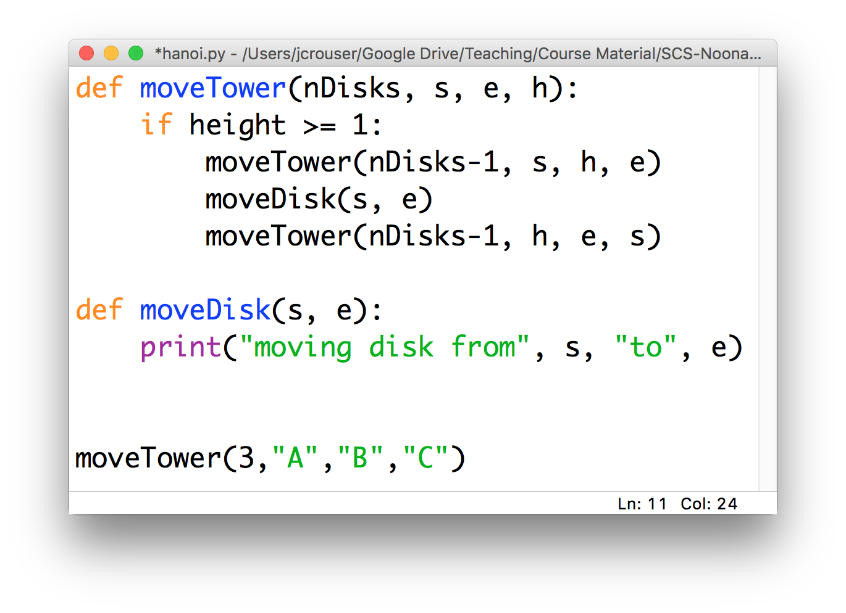
Recap: recursive functions (Hanoi)

Slide 11
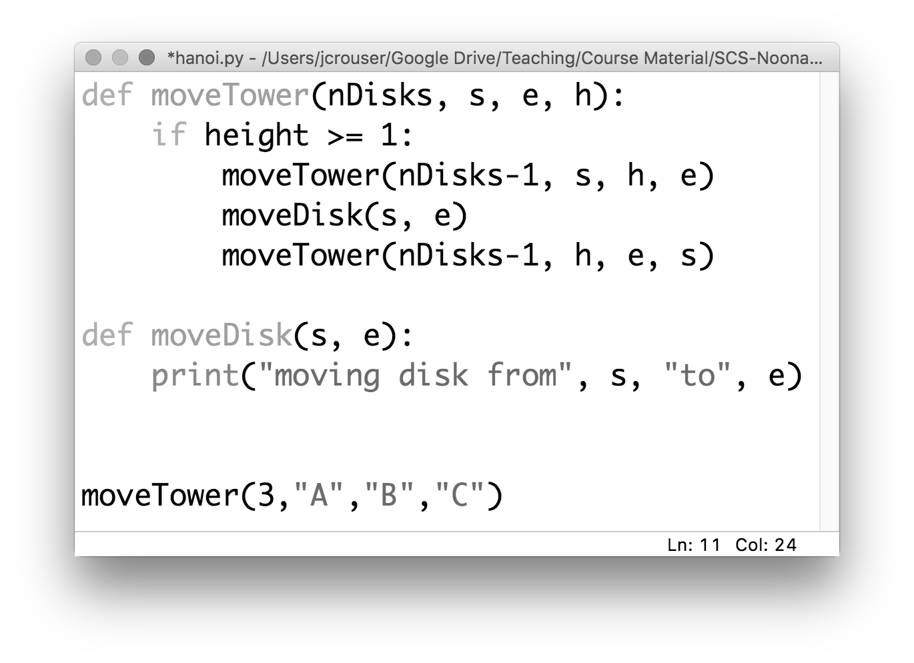
Recap: recursive functions (Hanoi)

Slide 12
Discussion
What actually happens in memory
when you call a function?

Slide 13
the “stack”
the program
in memory
def f1(a):
y = f2(a+1)
return y
def f2(b):
z = b
if (z > 2):
z = z/2
return b^2
f1(3)

Slide 14
the “stack”
the program
in memory
def f1(a):
y = f2(a+1)
return y
def f2(b):
z = b
if (z > 2):
z = z/2
return b^2
f1(3)

Slide 15
the “stack”
the program
in memory
def f1(a):
y = f2(a+1)
return y
def f2(b):
z = b
if (z > 2):
z = z/2
return b^2
f1(3)
f1(3): y

Slide 16
the “stack”
the program
in memory
def f1(a):
y = f2(a+1)
return y
def f2(b):
z = b
if (z > 2):
z = z/2
return b^2
f1(3)
f1(3): y

Slide 17
the “stack”
the program
in memory
def f1(a):
y = f2(a+1)
return y
def f2(b):
z = b
if (z > 2):
z = z/2
return b^2
f1(3)
f2(4): z
f1(3): y

Slide 18
the “stack”
the program
in memory
def f1(a):
y = f2(a+1)
return y
def f2(b):
z = b
if (z > 2):
z = z/2
return b^2
f1(3)
f1(3): y

Slide 19
the “stack”
the program
in memory
def f1(a):
y = f2(a+1)
return y
def f2(b):
z = b
if (z > 2):
z = z/2
return b^2
f1(3)
…whatever’s next!

Slide 20
Discussion
What actually happens in memory
when you call a function
recursively?

Slide 21
the “stack”
the program
in memory
…
def f3(a):
if (a == 1):
return 1
else:
x = f3(a-1)+1
f3(100)
f3(97): x
f3(98): x
f3(99): x
f3(100): x
…but isn’t there limited space?

Slide 22
Demo: recursive addition

Slide 23
Trivia
Ever wonder where the name
came from?

Slide 24
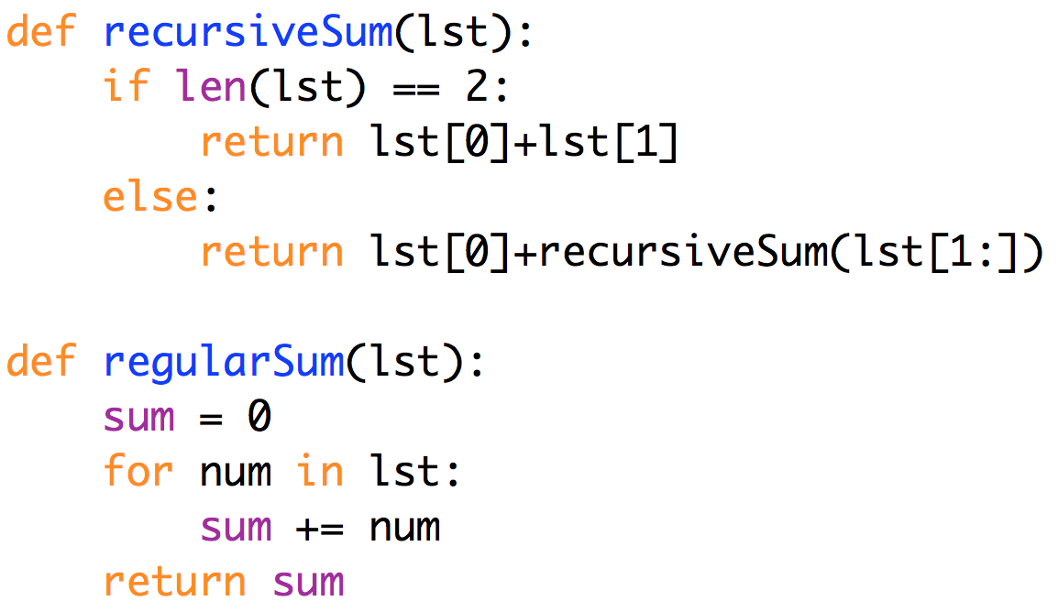
Recursive vs. iterative addition
in this case,
the iterative solution
feels cleaner
Notes:
Anything you can write recursively, you can also write iteratively. This avoids the issue of having to duplicate all the local variables, etc. and so poof! No more recursion depth issues.
Moreover, some problems just seem to make more sense as a loop.

Slide 25
Discussion
How would you solve Tower of Hanoi iteratively?
Notes:
It’s always the case that you CAN rewrite recursive code as iterative code. But it isn’t always pretty.
It’s really hard to describe, right?

Slide 26
More problems with recursive solutions
15 minute (non-programming) Challenge:
How would you program a robot to solve a maze?

Slide 27
A recursive solution
Mark your current location as visited
If you’re at the end, you’re done!
If not:
If unmarked, go NORTH, solve maze. If not solved, go back and:
If unmarked, go SOUTH, solve maze. If not solved, go back and:
If unmarked, go EAST, solve maze. If not solved, go back and:
If unmarked, go WEST, solve maze. If not solved, NO SOLUTION

Slide 28
Clever recursion allows backtracking!
Mark your current location as visited
If you’re at the end, you’re done!
If not:
If unmarked, go NORTH, solve maze. If not solved, go back and:
If unmarked, go SOUTH, solve maze. If not solved, go back and:
If unmarked, go EAST, solve maze. If not solved, go back and:
If unmarked, go WEST, solve maze. If not solved, NO SOLUTION

Slide 29
Discussion
What is the
most confusing thing
about recursion?

Slide 30
Outline
Motivating example: Towers of Hanoi
Fractals (quick introduction)
Lab 12: Debrief
Recap
How it works under the hood
Iterative vs. recursive solutions
More recursion & recursive functions
Break
Lab

Slide 31
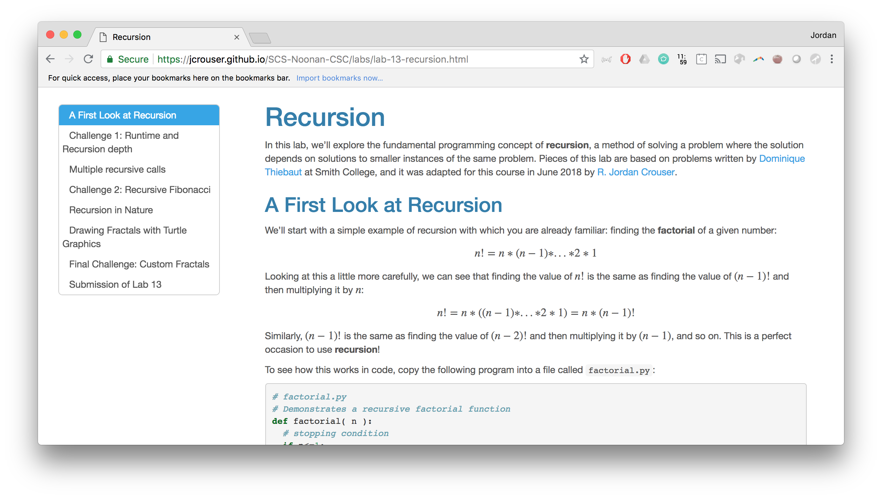
Lab 13: Recursion
Picking up where we left off yesterday…

Slide 32
This week
Monday: Mock Midterm
Tuesday: Introduction to Algorithms
Wednesday: Recursion pt. 1
Thursday: Recursion pt. 2
Friday: Life Skill #4: Code Reuse

